Slide 1

Hotel Management System DBMS (BCSE0452)
Department of Computer Science and Engineering
CSE
(Submitted To: Ms. Sana Anjum )
Student Name | Roll Number | Department & Section
MURALIDHAR | 2301331530098 | B.Tech CSE-A

Slide 2

Index
Introduction
Literature Survey/Existing System
Problem Statement
Proposed Methodology
ER Diagrams
Feasibility Study
Hardware /Software Requirement
Results and Conclusion
Reference
Live Demonstration of Project with screenshots in ppt
Notes:
Aaj

Slide 3
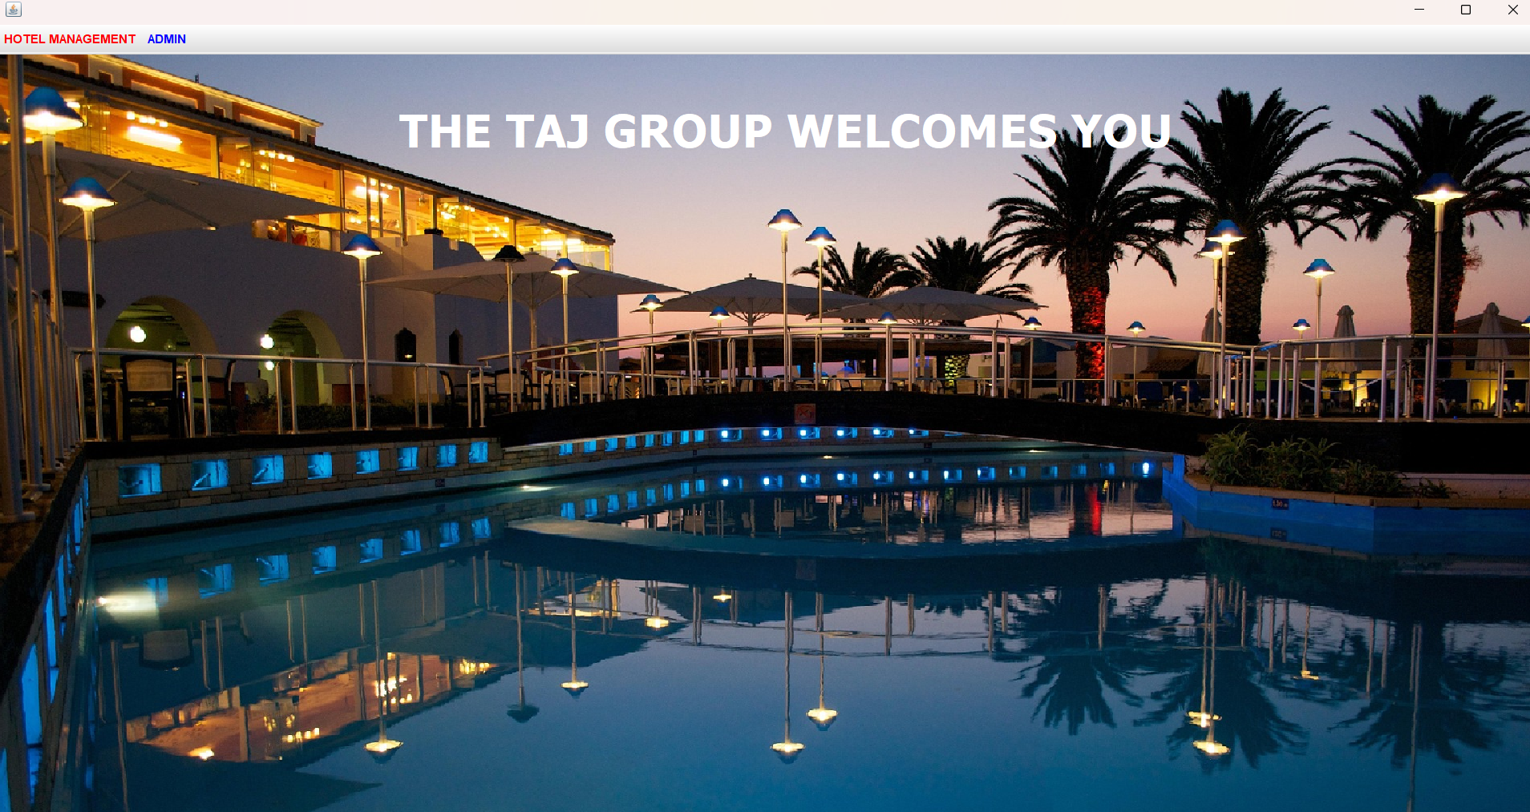
Introduction
A software solution designed to streamline and automate hotel operations like booking, room allocation, check-ins, check-outs, and billing. Its key features include reservation management, secure customer data storage, invoice generation, and analytics for better decision-making

Slide 4
Literature Survey/Existing System
Traditional hotel systems were manual – involved registers for booking, billing, and guest records.
Semi-automated tools like MS Excel improved record-keeping but lacked real-time updates.
Commercial software (e.g., Hotelogix, Cloudbeds) offers full automation but is expensive.
Modern trend: Custom hotel systems using Java + MySQL for cost-effective and tailored solutions.
Features include: room booking, check-in/check-out, billing, employee & inventory management.

Slide 5
Problem statement
Manual Processes
Limited Data Integration
Inconsistent Customer Experience
Lack of Real-time Updates

Slide 6
Proposed Methodology
The proposed Hotel Management System (HMS) will utilize modern technologies like Java Swing, AWT (Abstract Window Toolkit).
MySQL to build a robust, user-friendly, and efficient system. Below is the detailed methodology for developing this system.
Develop the system using Java Swing, AWT for the front end, and MySQL for the backend.
Test the system thoroughly to ensure all functionalities are working as expected.

Slide 7
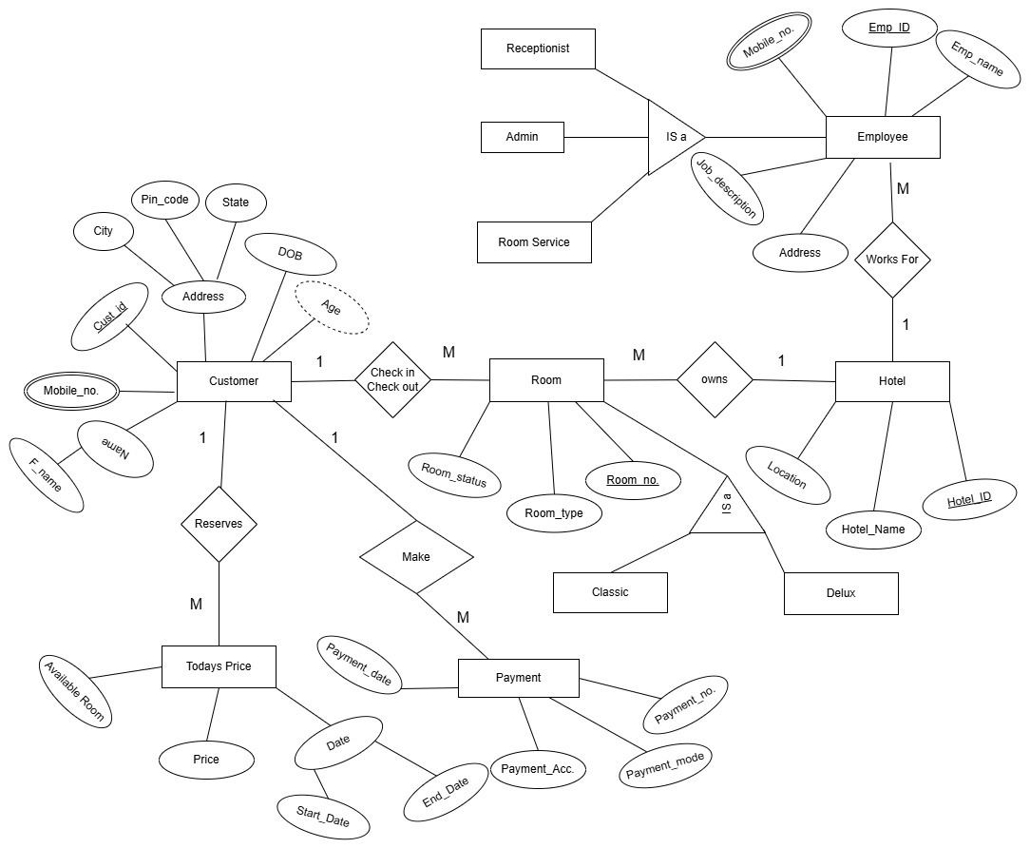
ER Diagram

Slide 8
Feasibility Study
A Feasibility Study is essential to evaluate the viability of a project in terms of its technical, operational, financial, and legal aspects. For the Hotel Management System (HMS) using Java Swing, AWT, and MySQL, this feasibility study will analyze the practicality of implementing the system from different perspectives.
Technical Feasibility
Operational Feasibility
Financial Feasibility
Legal Feasibility

Slide 9
Hardware /Software Requirement
Hardware and software requirements for developing and running the Hotel Management System (HMS) using Java Swing, AWT, and MySQL.
JAVA -> Netbeans
Database -> MySQL

Slide 10
Results and Conclusion
The Hotel Management System (HMS), developed using Java Swing, AWT, and MySQL, was designed to automate and streamline various hotel operations. Upon completing the system’s development, the following results were achieved.
Room Booking
Check-in/Check-out
To check room status
Adding Employee
Adding Customer

Slide 11
The Hotel Management System developed using Java Swing, AWT, and MySQL has proven to be a highly effective solution for automating the core operations of a hotel. The system successfully addresses the issues faced by traditional hotel management systems, such as
Manual record-keeping, leading to errors and inefficiencies
Limited real-time information on room availability and guest details.
Poor integration with payment systems and online booking platforms.

Slide 12
Reference
Java Swing Documentation
Link: https://docs.oracle.com/javase/8/docs/api/javax/swing/package-summary.html
Java AWT Documentation
Link: https://docs.oracle.com/javase/8/docs/api/java/awt/package-summary.html
MySQL Official Website
Link: https://www.mysql.com/
MySQL JDBC Connector
Link: https://dev.mysql.com/downloads/connector/j/

Slide 13
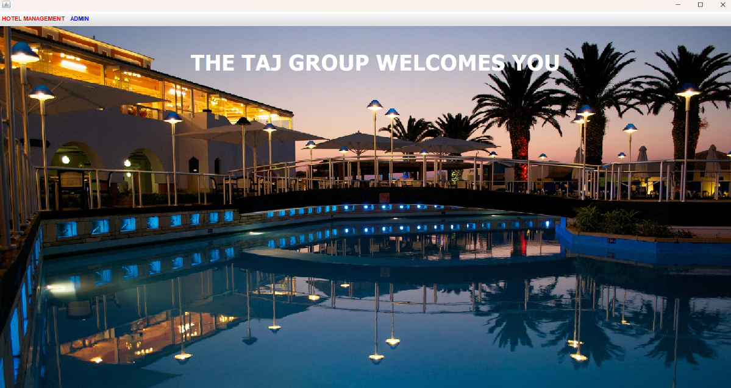
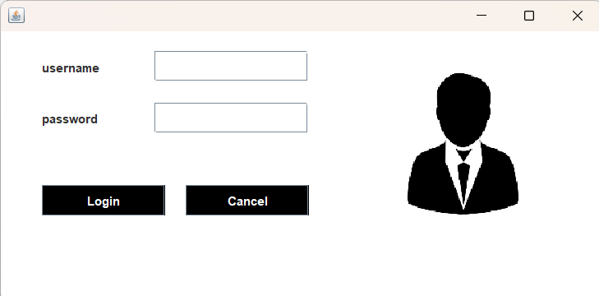
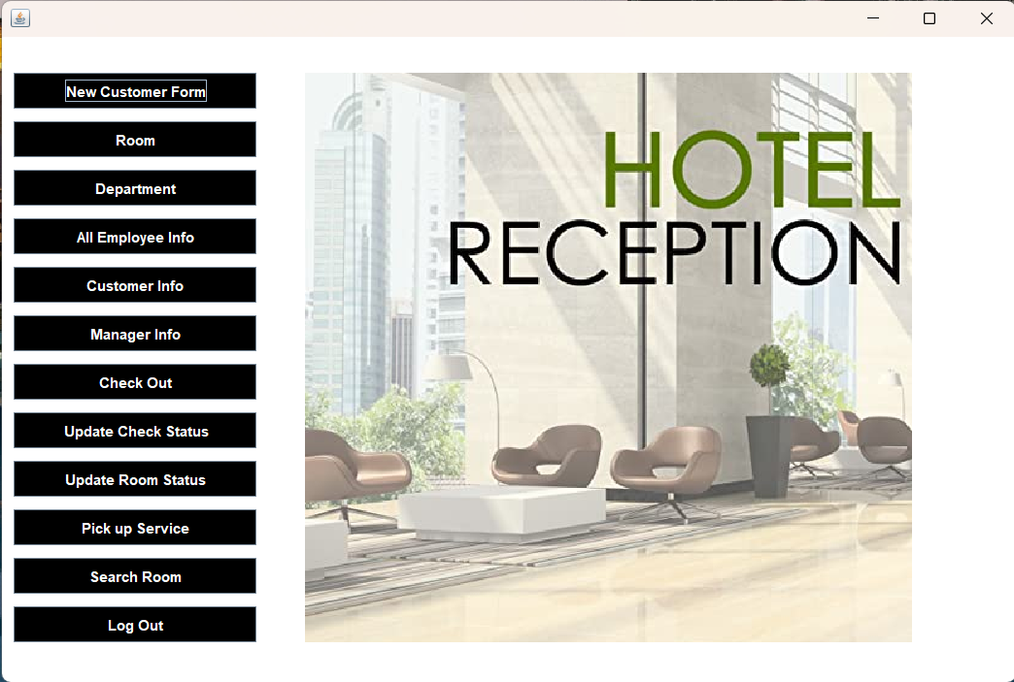
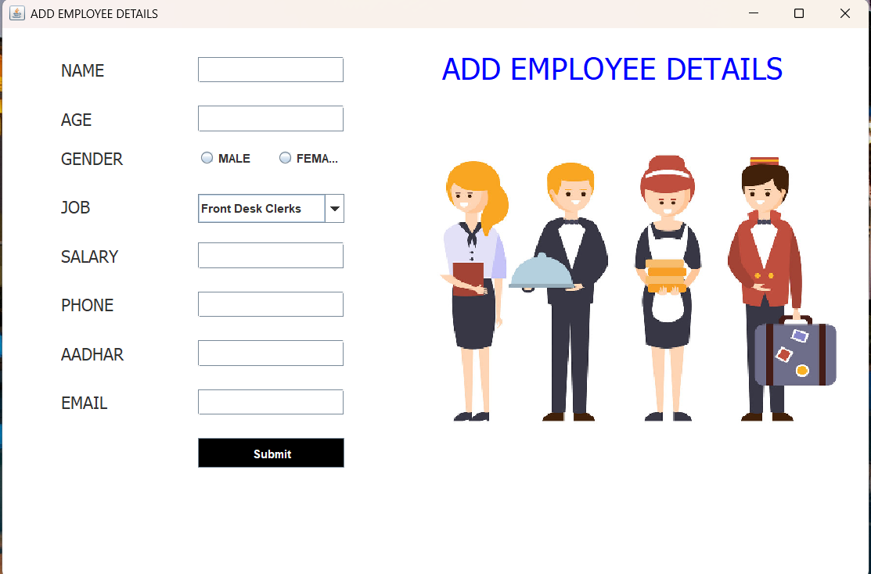
Snapshot

Slide 14
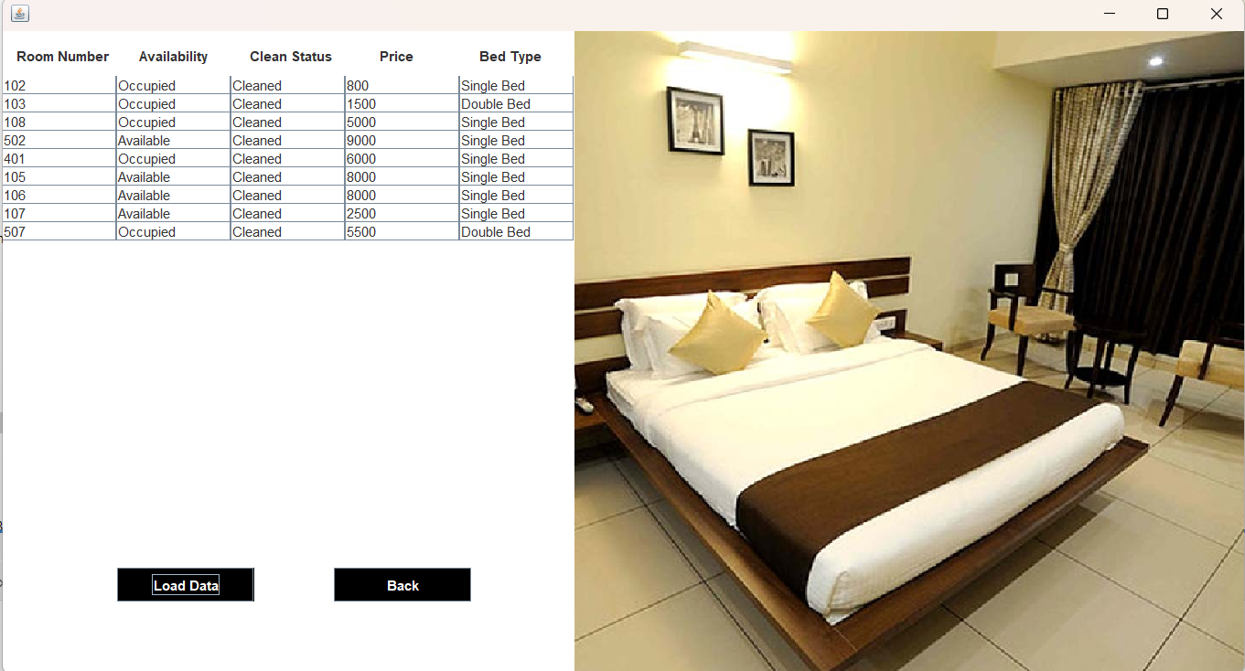
Room Status

Slide 15
Thank You

Slide 16
Feedback from the Panel

